Slide 2

MID-TERM PROGRESS REPORT
Cross VM Side-Channel Attacks on L1 I-Cache
by Aditya Wate
Image courtesy of Stuart Miles at FreeDigitalPhotos.net

Slide 3
Side Channel Attacks
Time-driven: Statistically inferring from execution timing
Trace-driven: Monitoring some aspect of the device
Access-driven: Usage of a shared architectural component

Slide 4
Setup
Dom0
DomU
DomV
VCPU
Core 0
Core 1
Core 2
L1 Inst
L1 Data
L1 Inst
L1 Data
L1 Inst
L1 Data
PCPU
L2
L2
L2
Unified L3

Slide 5
Threat Model
Attacker and Victim are separate guest VMs
Logical isolation between mutually untrusting co-resident VMs
Software vulns are not exploited to gain root of the other machine

Slide 6
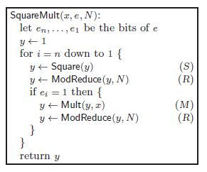
Classifying Code Paths
For e=2 the operation sequence will be SRMRSR

Slide 7
Cache pattern classifier
Classification of S,M and R vectors
Using SVM (support vector machine)
Training on a controlled but similar architecture machine
Communication of the results is required to get the readings
Utilize the memory pages shared between VMs

Slide 8
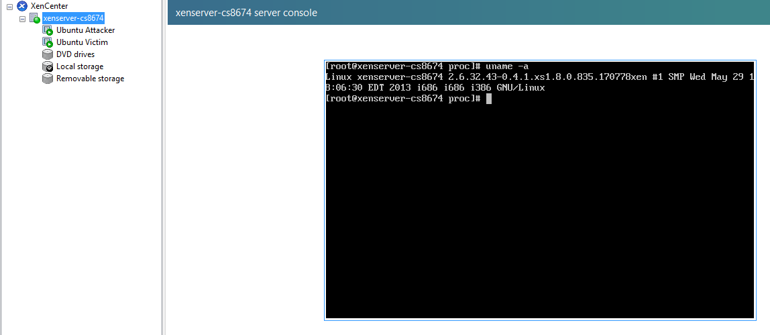
XenServer 6.2

Slide 9
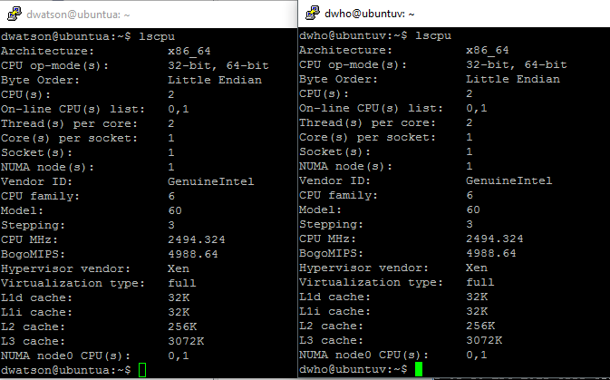
Processor Specs (lscpu)

Slide 10
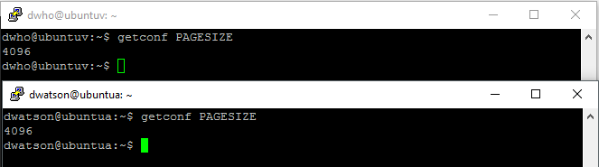
Memory Page

Slide 11
Mapping
Cache
m sets with w lines of b size, cache size = c.
m = c/(w*b)
m = 64 (c=32K, w=8, b=64B) = 2^6 (6 bits)

Slide 12
Mapping
Memory
m sets with w lines of b size
m = 64 (calculated previously)
Cache line blocks in memory page = 4K/b = 64
Memory blocks with the same offset will map to the same cache set

Slide 13
Mapping
Sets
Memory size = 1 GB = 2^30 (30 bits)
m = 64 (2^6)

Slide 14
Mapping
Address issued by Processor
30 address bits
6 bits for set selection
18 bits for tag
6 bits for block offset

Slide 15
Prime and Probe
Allocate page blocks equivalent to cache size
32 KB

Slide 16

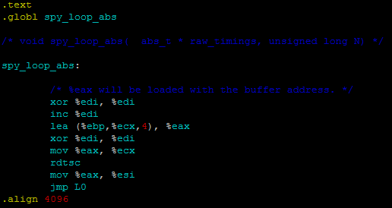

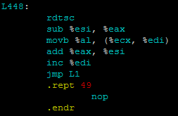
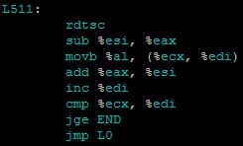
Prime and Probe

Slide 17
Prime & Probe: Strategy
Fill cache set associated to block offset i
Execute instruction in ith block of each of the allocated pages
t1:=rdtsc
Jump to first page’s ith block which has instruction to next pages ith block
Final page jumps to rdtsc (t2)
Time taken = t2-t1

Slide 18
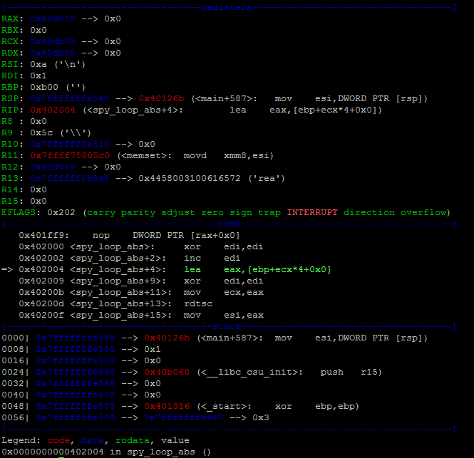
Prime and Probe: Issue

Slide 19
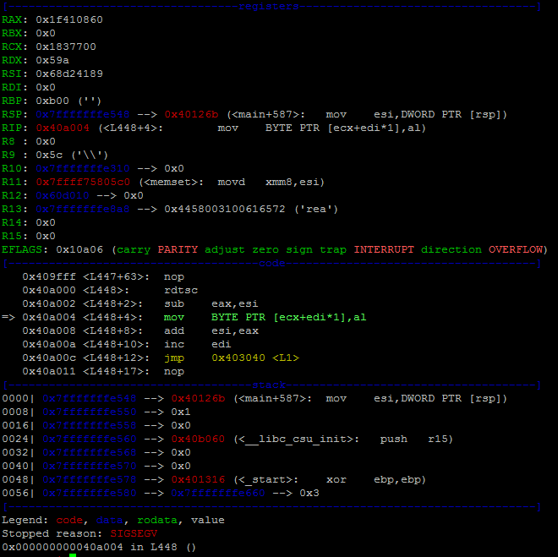
Prime and Probe: Issue

Slide 20
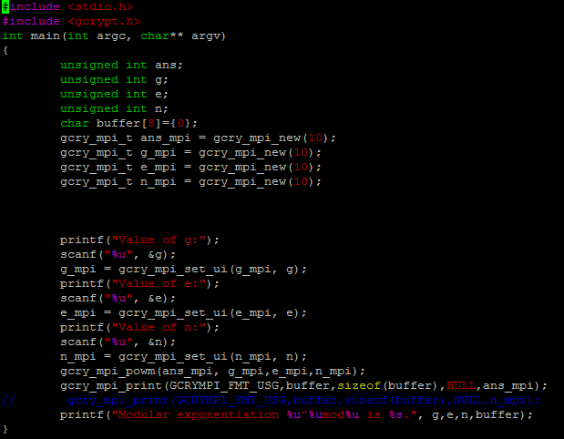
Modular Exponentiation

Slide 21
Measurement: TO-DO
Memory Sharing
  Grant Table
    http://wiki.xen.org/wiki/Grant_Table
  Libvchan
    http://xen.1045712.n5.nabble.com/Using-libvchan-library-td5720867.html
Notes:
Grant table’s tell what access do other VMs have, libvchan is like RPC

Slide 22
Measurement: TO-DO
Write a library to write the operations to the shared memory pages
Update the gcrypt mpi library and deploy it to the victim VM
Pinning Victim and Attacker to the same pCPU
  $ xl vcpu-pin <Domain> <VCPU> <CPU>

Slide 23
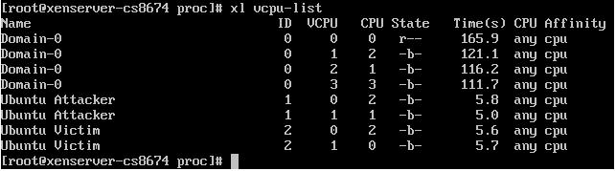
Domains

Slide 24
Next steps
Measurement
  In Progress
  Dependencies mentioned previously
Training
  libsvm
Actual Readings
  Detecting the key without CPU pinning and Shared memory

Slide 25
THANKS

